Slide 1

AI Shopping Agent
Smart Price Comparison Across Pakistani E-Commerce
Student: Faryal | CMS: 023-24-0079 | June 2026
Daraz
Goto
Shophive
GitHub: github.com/faryalkalwar66/AI-Shopping-Agent
Notes:
Introduce yourself and the project. Mention the GitHub link. Three sites searched simultaneously.

Slide 2
Introduction
What is the AI Shopping Agent?
A smart desktop application that helps users search and compare product prices across multiple Pakistani e-commerce platforms simultaneously. Users enter a product name — the system retrieves listings from Daraz, Goto & Shophive, caches results in MongoDB, and provides intelligent analytics.
❌ Problem
✅ Solution
Pakistani shoppers waste time checking 3+ websites manually to compare prices
One search. Three sites. Instant comparison. Best deal highlighted automatically.
⚡ Parallel scraping (threading) searches all 3 sites at once — no waiting!

Slide 3






Project Objectives
Fast Search
Price Comparison
Data Persistence
Make online product searching fast & easy for Pakistani consumers
Real-time price comparison across 3 major e-commerce platforms
Persist searches, favorites & products using MongoDB
Smart Analytics
Parallel Scraping
User Experience
Best deals, price trends, website stats & savings comparisons
Threading for simultaneous scraping across all three websites
Modern desktop GUI with favorites, history & category filtering

Slide 4
Technologies Used
The full technology stack powering the AI Shopping Agent
🐍
🍃
🔗
Python 3.x
MongoDB
PyMongo
Core application language
NoSQL database backend
Python-MongoDB driver
🕷
🖥
⚡
Selenium
CustomTkinter
Threading
Dynamic web scraping engine
Modern desktop GUI
Parallel scraping (3 sites)

Slide 5
System Architecture
👤 User / GUI (CustomTkinter)
▼
🤖 main.py — AI Agent Core
Daraz Scraper
Goto Scraper
Shophive Scraper
⚡ All 3 scrapers run simultaneously in parallel threads
▼
🍃 MongoDB — database.py

Slide 6


Key Features
Product Search
Price Comparison
Search Daraz, Goto & Shophive simultaneously with one query
Side-by-side price comparison with best deal highlighted automatically
Favorites
Search History
Save & manage favorite products persistently in MongoDB
Full history with deduplication and intelligent caching
Analytics
Modern GUI
Website stats, savings comparisons, category insights via aggregation
Desktop UI built with CustomTkinter — intuitive and fast

Slide 7
🍃 Database Design — MongoDB
all_products
search_history
favorite_products
▸ name
▸ product
▸ product
▸ price (int)
▸ date
▸ price (display)
▸ price_display
▸ time
▸ price_numeric (int)
▸ website
▸ website
▸ category
▸ link
▸ link
▸ date
▸ saved_at
MongoDB Ops: CRUD • Aggregation Pipelines • Regex Search • Upsert (Duplicate Prevention) • Price Sorting

Slide 8
Web Scraping Flow
How the agent finds and stores products across platforms
1
2
3
4
5
→
→
→
→
User Enters Product Name
Thread Pool Launched (×3)
Selenium Scrapes Sites
Results Parsed & Cleaned
Saved to MongoDB
💡 Smart Caching: If product was searched before, MongoDB serves cached results — no re-scraping!
Platforms:
Daraz.pk
Goto.com.pk
Shophive.com

Slide 9
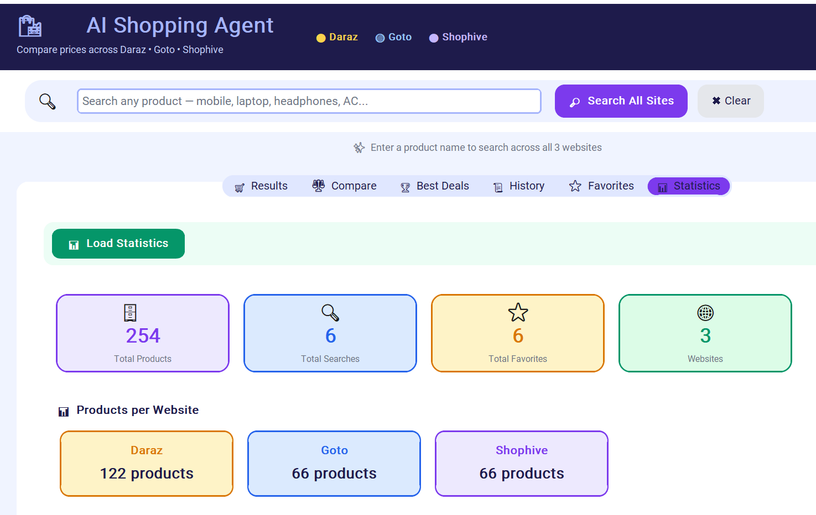
📊 Analytics & Insights
50
3
5
Total Products
E-Commerce Sites
Categories

Slide 10
Sample Product Data
Product Name | Price (PKR) | Website | Category
Samsung Galaxy A55 5G 8GB/256GB | Rs. 89,999 | Daraz | Mobile
iPhone 15 128GB Black | Rs. 289,999 | Daraz | Mobile
MacBook Air M2 8GB/256GB Space Gray | Rs. 319,999 | Goto | Laptop
Sony WH-1000XM5 Wireless ANC | Rs. 79,999 | Daraz | Headphones
Samsung 55 inch 4K QLED Smart TV | Rs. 159,999 | Daraz | TV
Apple MacBook Pro M3 14-inch 8GB | Rs. 499,999 | Shophive | Laptop
Dawlance Inverter 1.5 Ton Elegance | Rs. 94,999 | Daraz | AC

Slide 11
MongoDB — CRUD Operations
C
R
U
D
CREATE
READ
UPDATE
DELETE
▸ save_search(product)
▸ get_all_products()
▸ update_favorite_price(name, ...)
▸ delete_product(name, site)
▸ save_product(name, price, ...)
▸ search_products_db(name)
▸ update_product_category(name, ...)
▸ delete_favorite(name)
▸ save_favorite(name, price, ...)
▸ get_best_deal(product)
▸ delete_all_searches()
▸ compare_prices(product)

Slide 12

Conclusion
AI Shopping Agent successfully demonstrates web scraping, NoSQL database management, and GUI development — delivering real value to Pakistani online shoppers.
🔍 Parallel scraping across Daraz, Goto & Shophive
🍃 MongoDB collections + aggregation pipelines
⚡ Intelligent caching reduces redundant requests
📊 Real analytics — best deals, trends, website stats
Thank You! — Questions?

